Slide 1
Visualizing Multivariate Data & Models with R A preview
Michael Friendly
QM Forum, Mar. 2024
https://friendly.github.io/Vis-MLM-book/

Slide 2
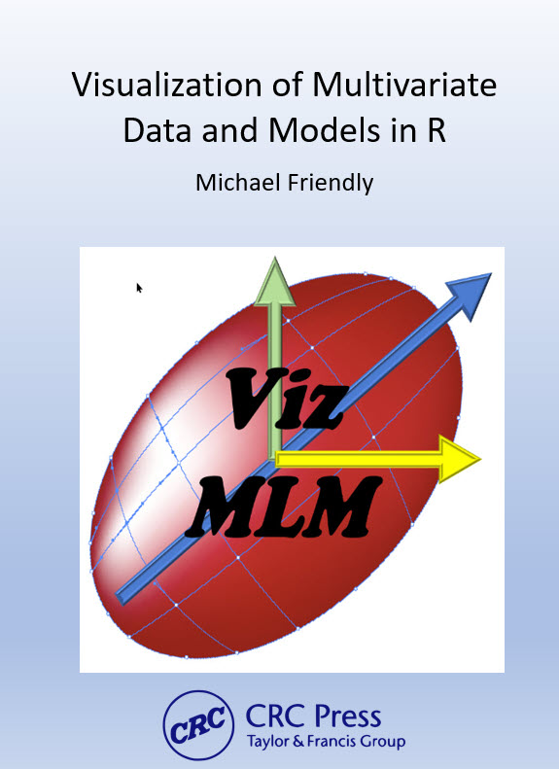
Goal: Extend the familiar graphical methods for univariate linear models to the MLM (MANOVA, MMRA, CDA, …)
Topics:
Data plots, model plots, diagnostic plots
Data ellipses, confidence ellipses
PCA, biplots (the multivariate juicer)
y ~ X β → Y ~ X B (Anova→MANOVA)
Hypothesis-Error (HE) plots
Canonical discriminant plots
…

Slide 3
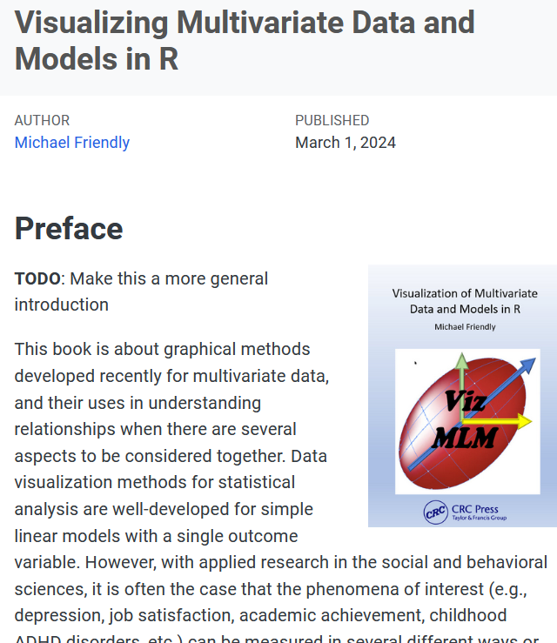
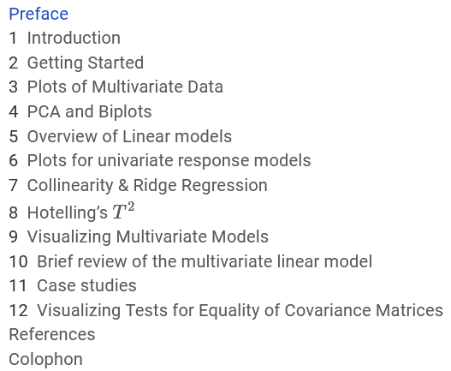
Using:
Quarto
HTML: easy
LaTeX/PDF: a challenge

Slide 4
Publication goals
Main goal: Publish the book w/ CRC Press
LaTeX format, krantz style
Make the printed book attractive, as in DDAR
Comprehensive indexing
Also: online free HTML version
Use online features:
code folding (toggle on/off)
tabbed displays to show alternatives
Animated graphics (GIFs)
Dynamic/interactive graphics ??

Slide 5
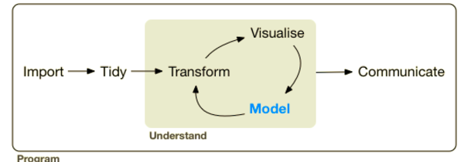
Process
Data analysis (Tidyverse)
Book writing
Idea
Example
Visualize
Outline
Finish writing
Intro
Write
Tweak code, revise pkgs

Slide 6
Topics for today
The LM Family & Friends
Plots for multivariate data
Plots for MLMs
Diagnostic plots for MLMs

Slide 7
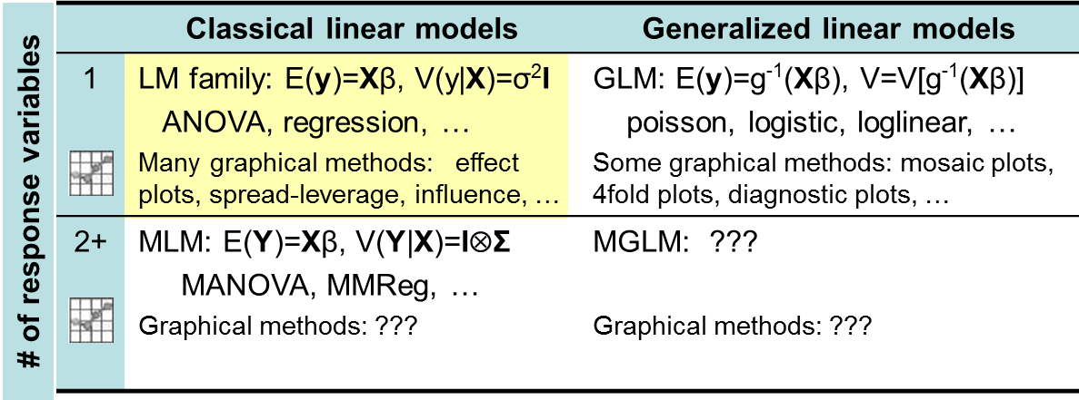
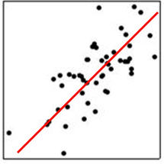
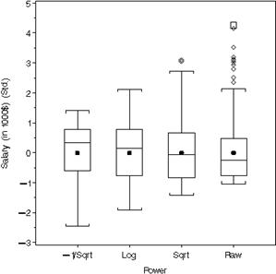
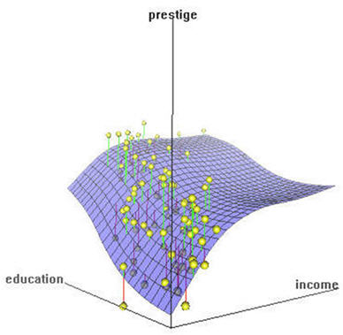
The LM family & friends
Models, graphical methods & opportunities

Slide 8
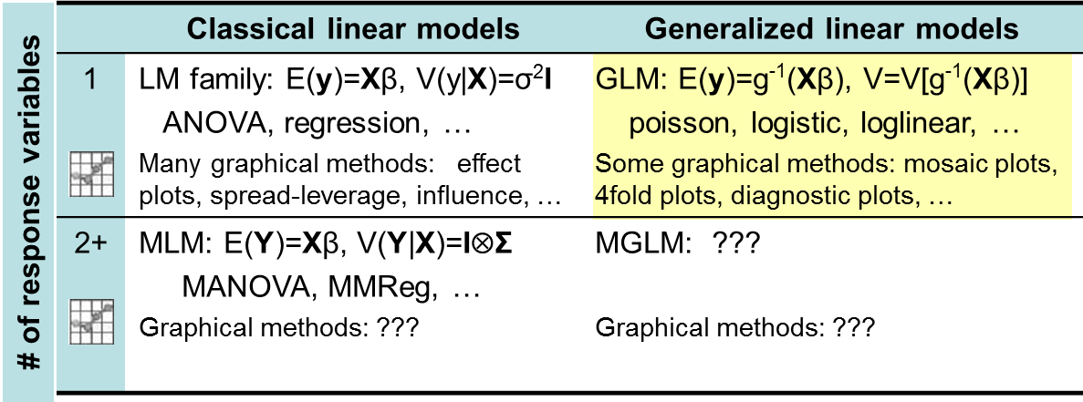
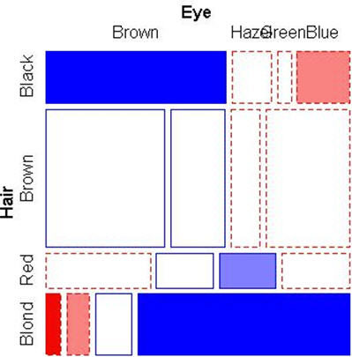
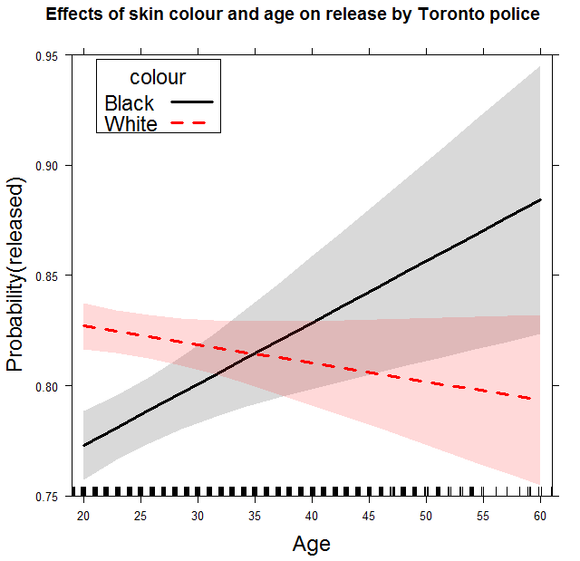
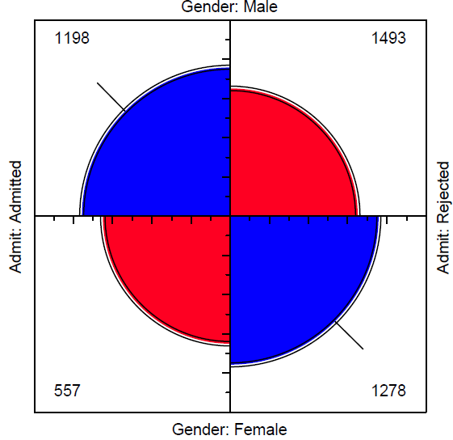
The LM family & friends
Models, graphical methods & opportunities

Slide 9
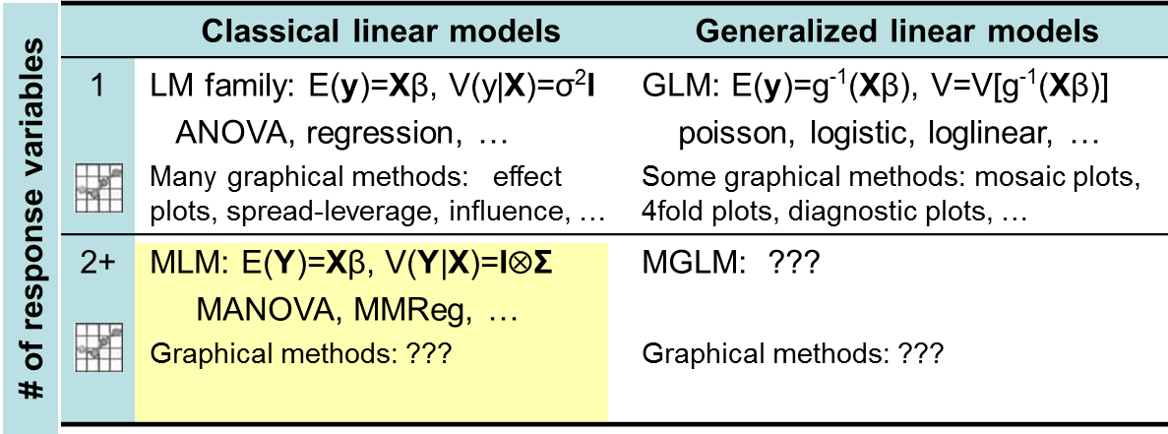

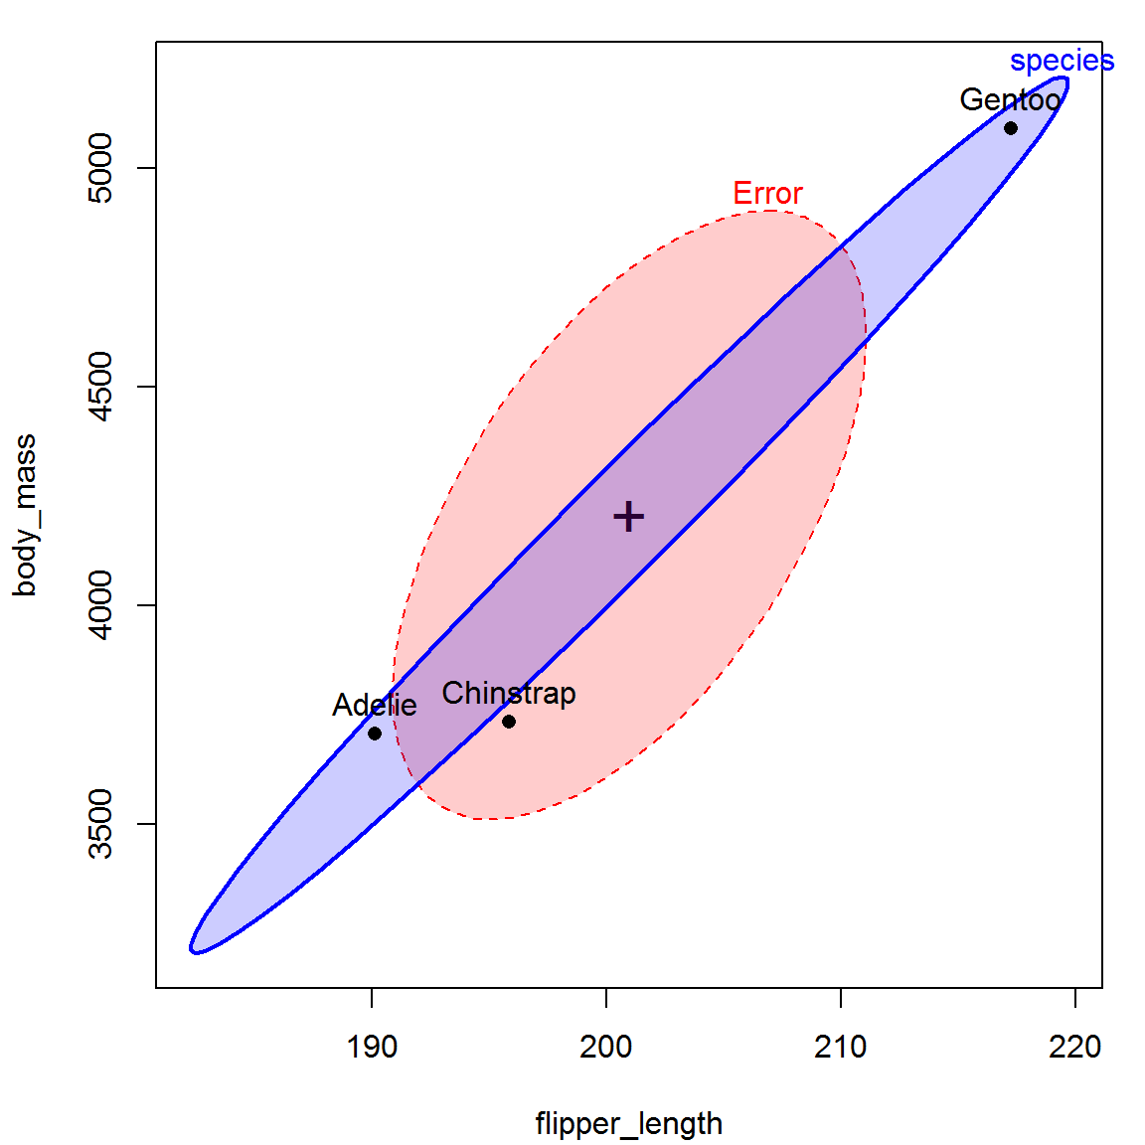
The LM family & friends
Models, graphical methods & opportunities
Today: HE plots & related methods

Slide 10
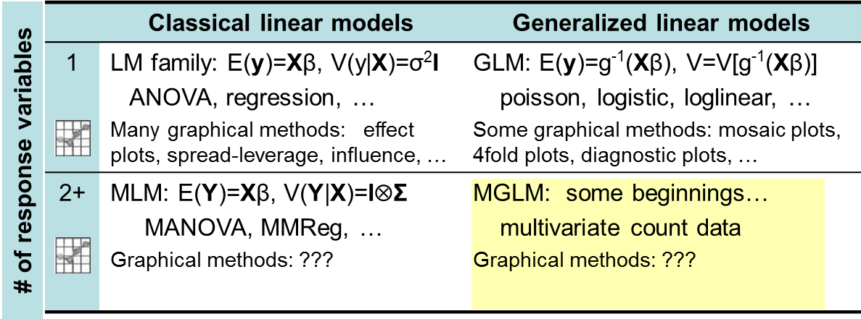
The LM family & friends
Models, graphical methods & opportunities
Tomorrow: Someone’s PhD thesis (better models)
Applications: big data, genomics, … beg for better graphical methods

Slide 11

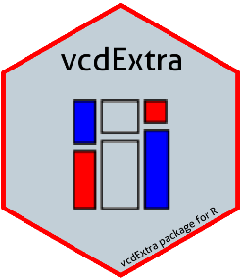

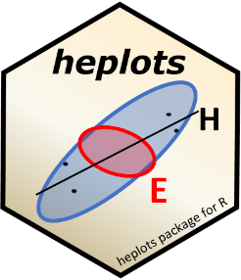
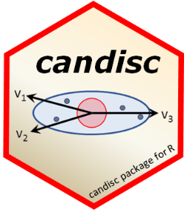



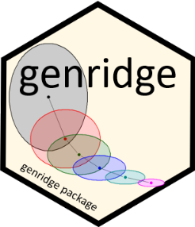

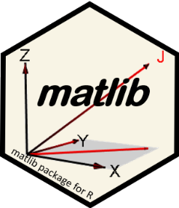
Software: packages
Categorical data
vcd & vcdExtra
nestedLogit: nested dichotomies
Linear & multivariate models
heplots: HE plots & related methods
candisc: Analyze/view MLMs in low-D space
mvinfluence: Multivariate influence
ggbiplot: ggplot2 biplots for PCA & LDA
VisCollin: Visualizing collinearity diagnostics
genridge: Generalized ridge trace plots
gellipsoid: Generalized ellipsoids
matlib: Matrix linear algebra, 2D & 3D
See: https://github.com/friendly/friendly/blob/main/packages.md
Notes:
To this end, I’ve developed a variety of R packages …

Slide 12
Plots for data analysis
data plots: display raw data, with annotations to aid interpretation (regression lines, smooths, data ellipses)
reconnaissance plots: bird’s-eye overview for high-D multivariate data
scatterplot matrices, corrgrams, parallel coord plots
visual thinning: favor summaries over data points
dimension reduction plots: plot in low-D space
PCA, biplots
Canonical correlation, LDA
model plots: plot results of a fitted model
coefficient plots
marginal effect plots, added variable plots, …
diagnostic plots: show deviations from assumptions
residual plots, influence plots
homogeneity of variance plots, …

Slide 13
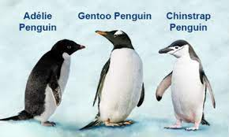
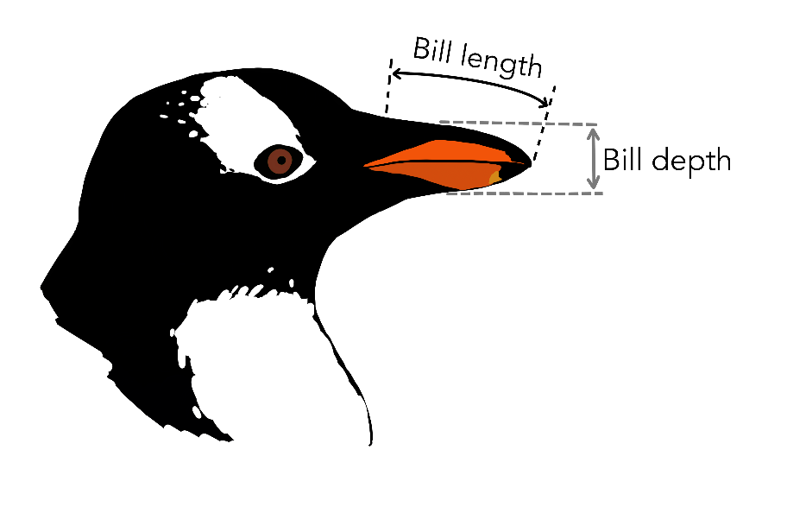
Penguins data
Data on penguin species observed in the Palmer Archipelago
Species: Adélie, Chinstrap & Gentoo
Islands: Biscoe, Dream & Torgersen
Years: 2007, 2008, 2009
Sex: Male, Female
Four measures: Bill length, Bill depth, Flipper length, Body mass
Body mass
Flipper length
Purpose: examine diff^{ces} in size, appearance in relation to foraging & habitat

Slide 14
Plots for multivariate data
Annotated scatterplots
Scatterplot matrices
Generalized pairs plots
Parallel coordinate plots
Dynamic tours

Slide 15
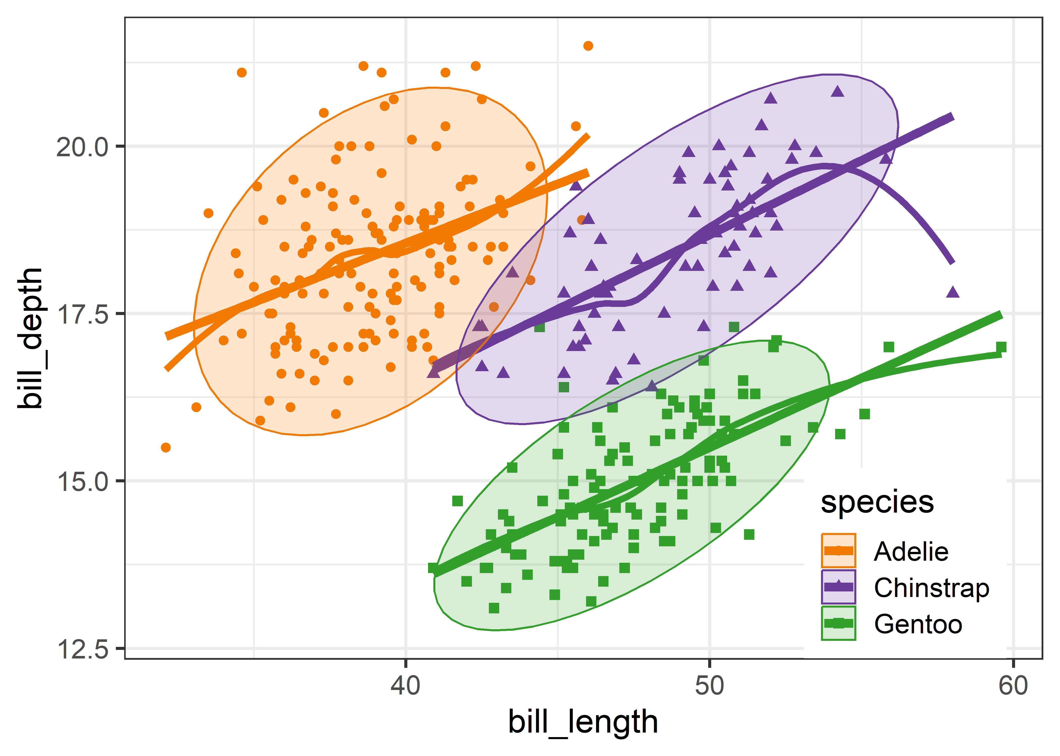
Annotated scatterplots
Basic scatterplots are most useful when supplemented by annotations to show patterns, trends and anomalies
Data ellipses, linear & loess smooths

Slide 16
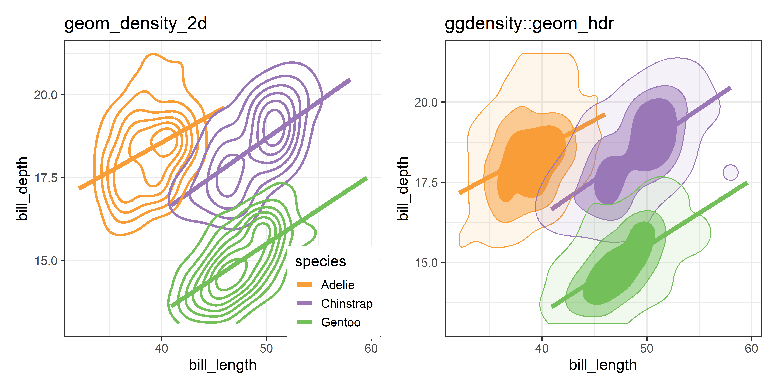
Non-parametric contours
Non-parametric contours can reveal more features
Bimodality? Outliers?

Slide 17
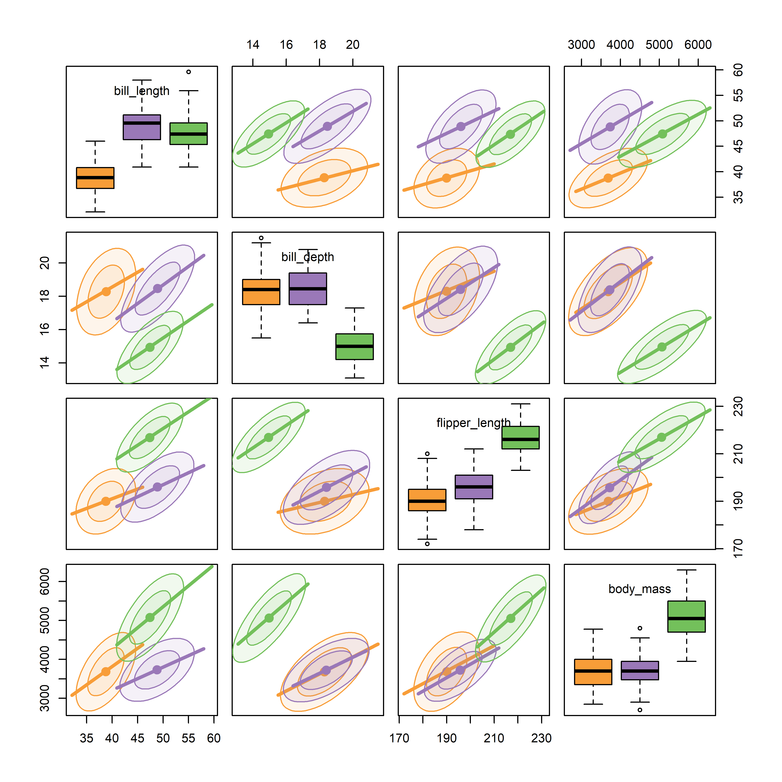
Reconnaisance: scatterplot matrices
For a graphic overview, it helps to thin details and emphasize visual summaries
Using car::scatterplotMatrix() here, but:
- points, loess
+ regression lines
+ data ellipses
Can see:
Reg lines have mostly similar slopes
Diff^{ces} in means shown in diag panels

Slide 18
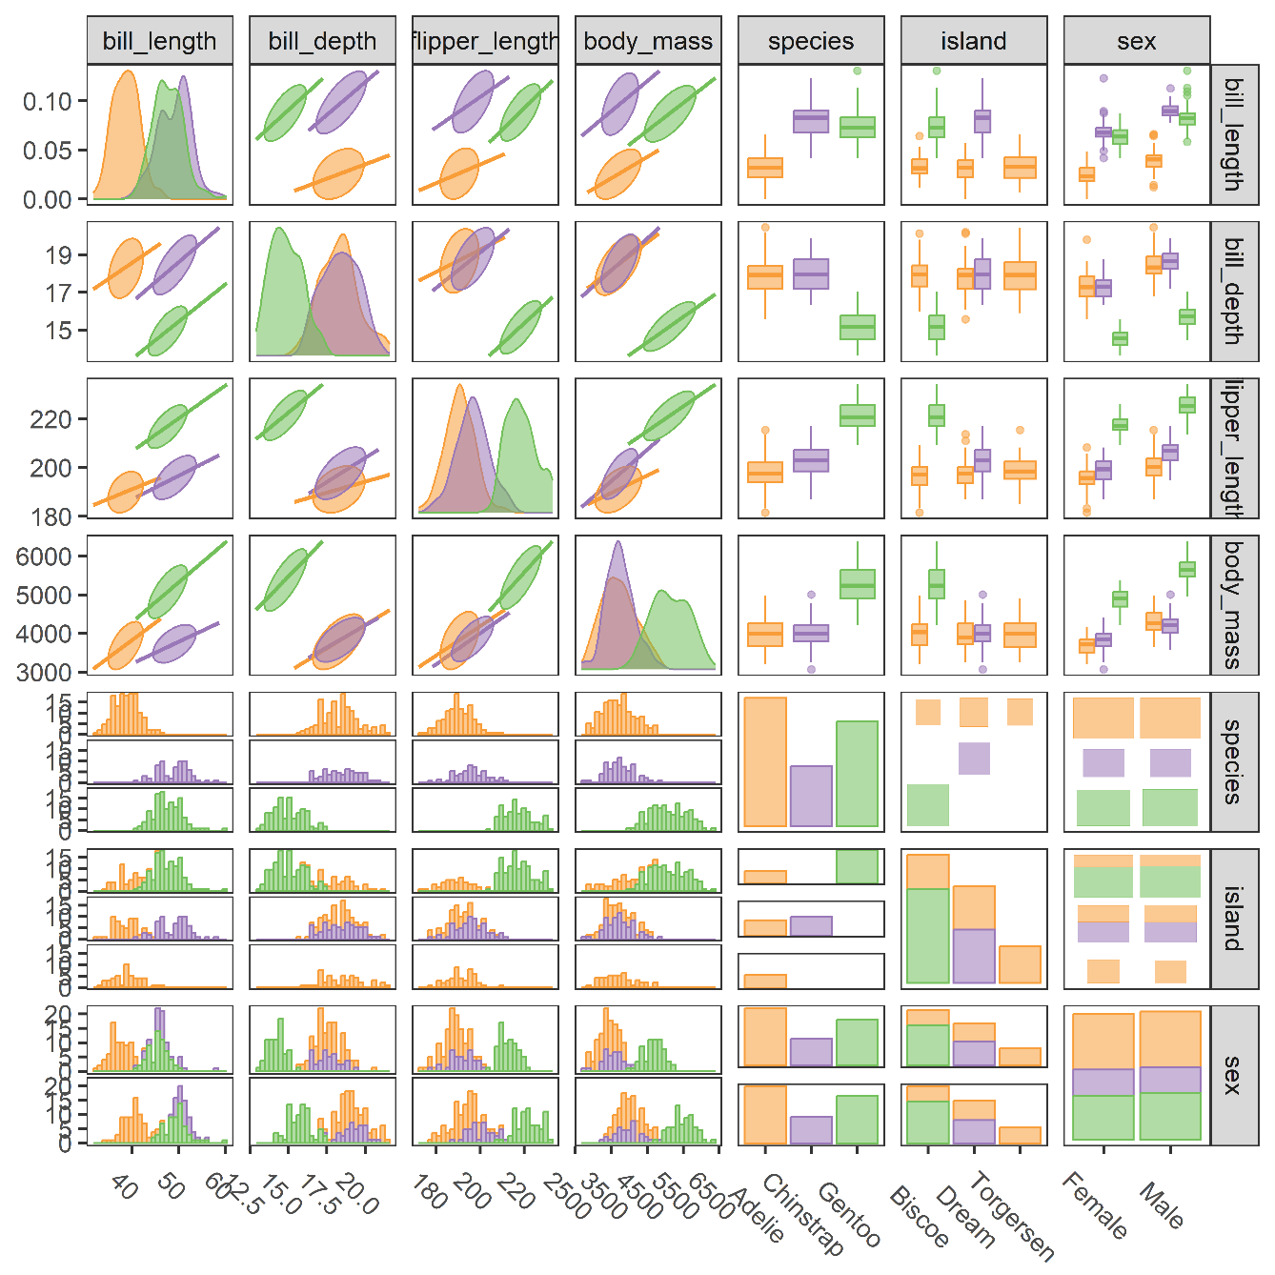
Generalized pairs plots
GGally::ggpairs() allows to view mixtures of Quantitative & Categorical variables
QQ: scat plots, densities, …
QC: boxplots, histograms, …
CC: mosaic plots, …
Sometimes we find something unexpected

Slide 19
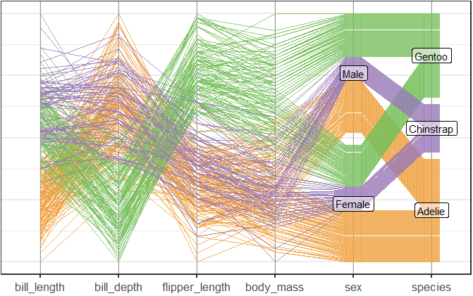
Parallel coordinates plots
ggpcp package provides pcp_*() extensions to ggplot2, handling both quantitative and categorical variables.

Slide 20
Animated tours
How can we usefully explore High-D data space to uncover interesting structure?
Clusters, holes, outliers, non-linearities
Asimov (1985) defined the idea of a Grand Tour
Orthogonal projection of Hi-D data X into d=1, 2, 3 D space
Tour: Smooth sequence of interpolated projections that can be animated as in a movie
Guided Tour methods include projection pursuit, to optimize some criterion

Slide 21
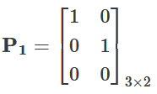
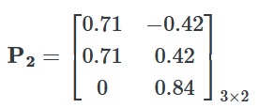
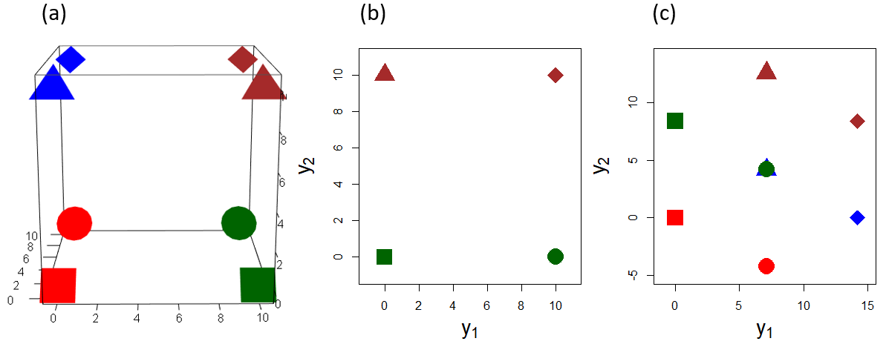
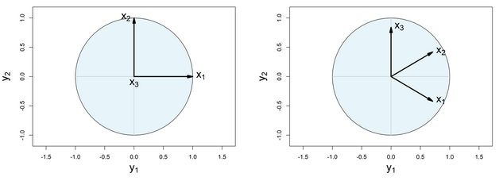
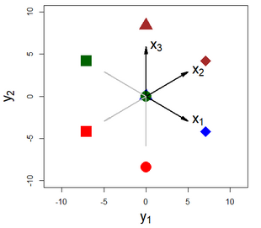
Projection example
X_{8×3} points on a unit cube
Variable vectors
P₂ Combined view

Slide 22
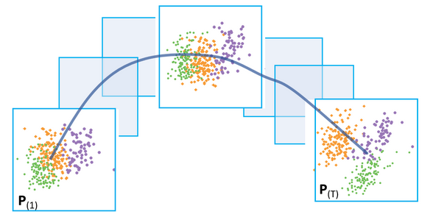
Tours
A tour consists of a smooth sequence of projections, P_{(t)} indexed by time t
Y₍₁₎ = X P₍₁₎ , Y₍₂₎ =X P₍₂₎ , …, Y_{(T)} = X P_{(T)}

Slide 23
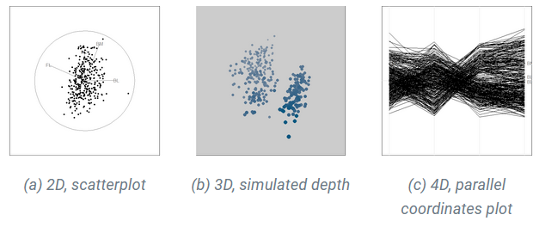
The tourr package
Defines a tour to consist of:
Data: a numeric matrix, X (n × p)
Path: a tour function giving d-dim projections P (p × d)
Display: a rendering function
peng_scaled <- scale(peng[,3:6])
colnames(peng_scaled) <- c("BL", "BD", "FL", "BM")
animate(peng_scaled, grand_tour(d = 2), display_xy())
animate(peng_scaled, grand_tour(d = 3), display_depth())
animate(peng_scaled, grand_tour(d = 4), display_pcp())

Slide 24
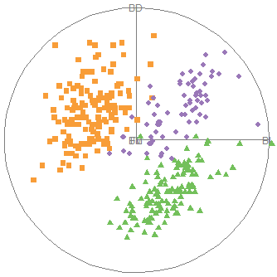
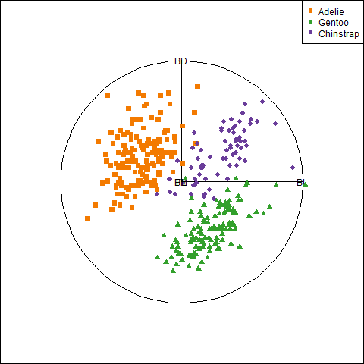
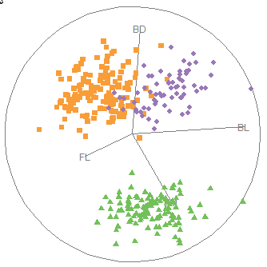
Penguin tours
animate(peng_scaled, grand_tour(d=2), display_xy())
Frame1: BD & BL only
Frame10: widely separated

Slide 25
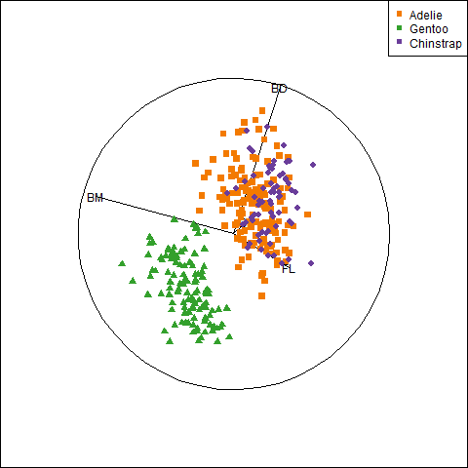
Guided tours
Guided tours take you on a journey through p-Dim space, seeing the most interesting sights by some criterion
Find projections to maximize some f(X P)
animate(data, guided_tour(holes())) # opt. find gaps / clusters
animate(data, guided_tour(lda_pp(group))) # opt. separation of groups (LDA/MANOVA)
animate(data, guided_anomaly_tour()) # opt. finding outliers
animate(peng_scaled,
guided_tour(lda_pp(peng$species))
BL primarily separates Adelie from others
BD separates Gentoo from others
BM, FL also distinguish Gentoo from others

Slide 26
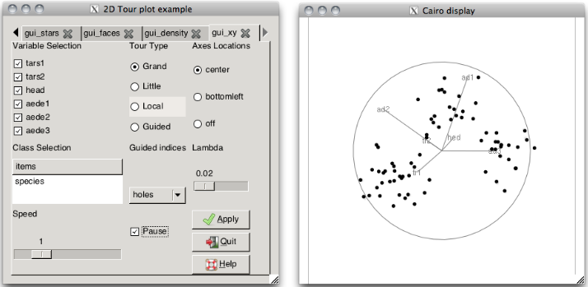
Interactive tours?
Interactive methods necessary to be truly useful
Select, identify, highlight points
Change tour methods & parameters
tourGUI package did this, but no longer maintained
JSS paper: tourrGui: A gWidgets GUI, https://www.jstatsoft.org/article/view/v049i06

Slide 27
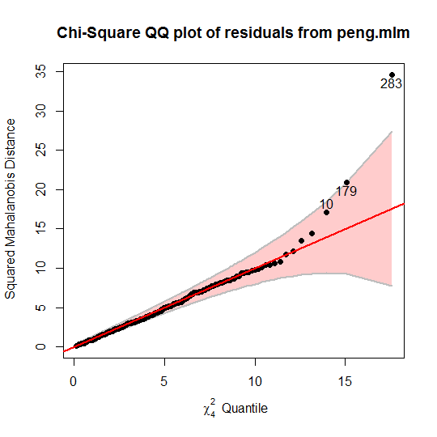
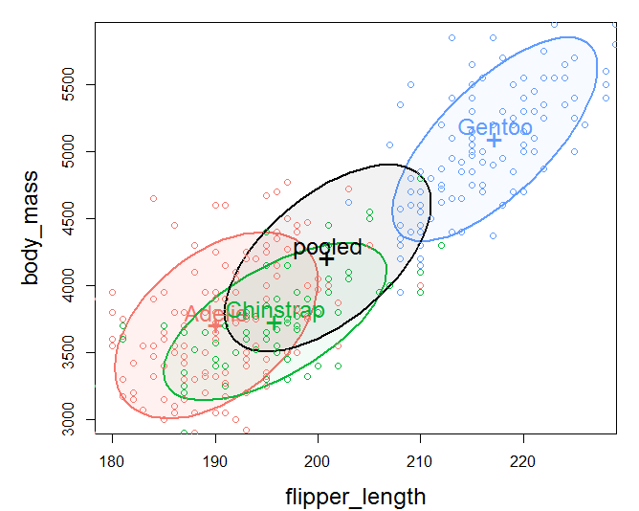
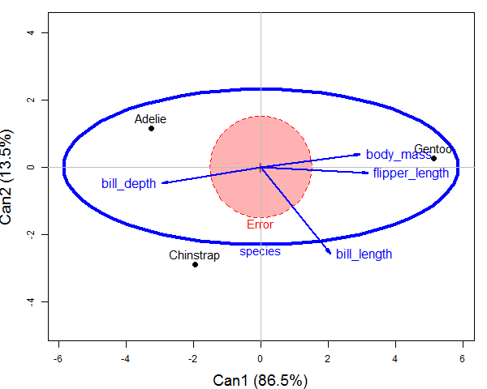
MLM visualization: Overview
Univariate linear models, y = Xβ + ε well developed
data plots, marginal effect plots, diagnostic plots
What about the MLM: Y = XB + E ?
data: data ellipses
multivariate effects: heplots
reduced-rank displays: canonical discriminant plots
diagnostic plots: MVN χ² QQ plot, mvinfluence plot
Notes:
I began this work on multivariate visualization from the thought that graphical methods were well developed for linear models for a single response variable
The extension to multivariate linear models is very direct mathematically:
Sums of squares -> square matrices for fitted values and residuals
Standard F tests -> tests based on eigenvalues

Slide 28
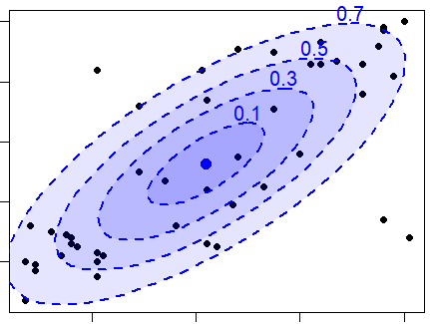
Data ellipsoids
For a p-dimensional multivariate sample, Y_{N×p} , the sample mean vector, , and sample covariance matrix, S, are minimally sufficient statistics under classical (Gaussian) assumptions.
These can be represented visually by the p-dimensional data ellipsoid, of size (“radius”) c,
→ an ellipsoid centered at the means whose size & shape reflects variances & covariances
Contours are Mahalanobis D_{M}² (y_{i}) ~ χ_{p}²
I consider this a minimally sufficient visual summary of multivariate location and scatter.

Slide 29
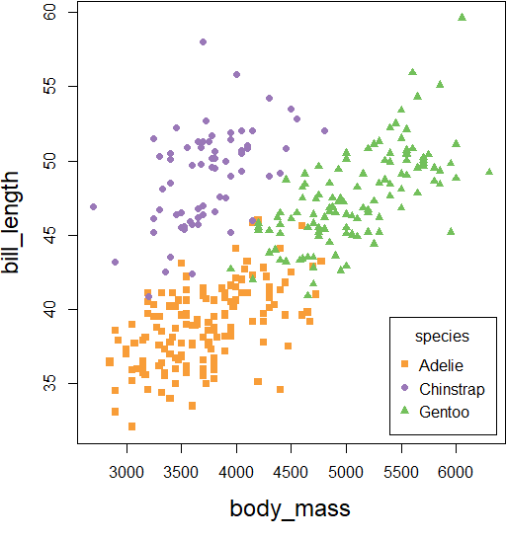
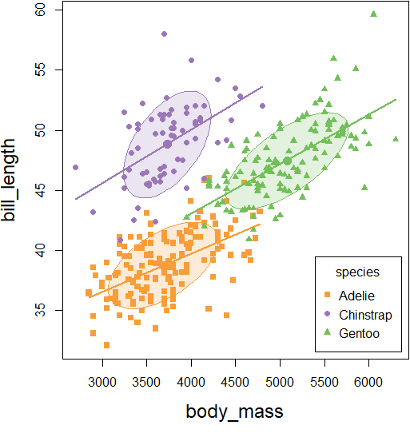
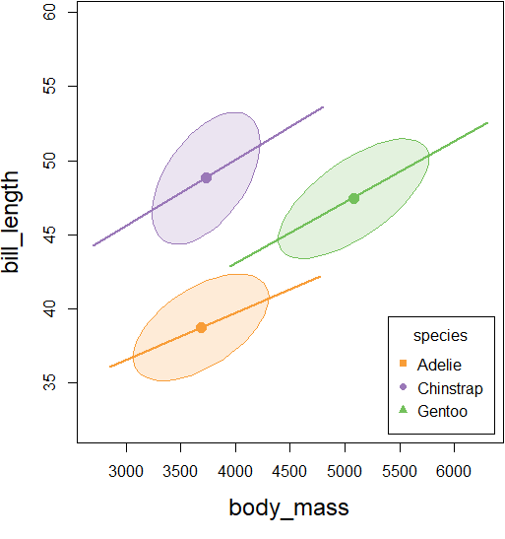
Data ellipses: Sufficient visual summary
Penguins data: Measures of bill length & depth, body mass, flipper length for 3 species
Add data ellipses to show w/in group means & scatter
Remove the points to show the overall patterns: means, shape, corr., precision
What remains is all that linear models care about (ellipses can be made robust!)
Standard scatterplot
Add data ellipses
Remove points
Notes:
As an example, consider the now popular data on body measurements of Antarctic penguins classified by species.
(The classic iris data seems to have been eclipsed b/c of Fisher’s association with the eugenics movement.)

Slide 30
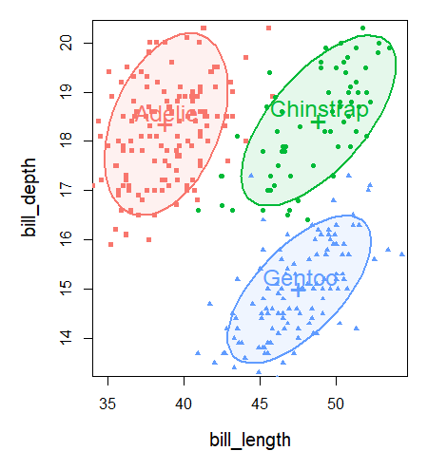
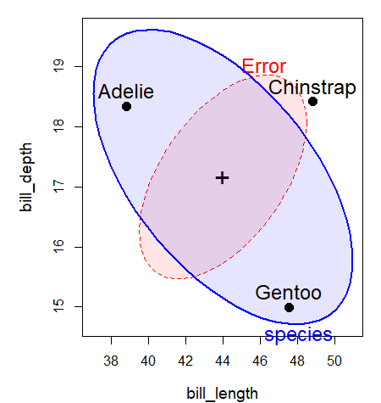
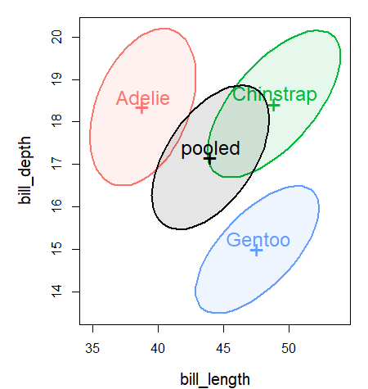
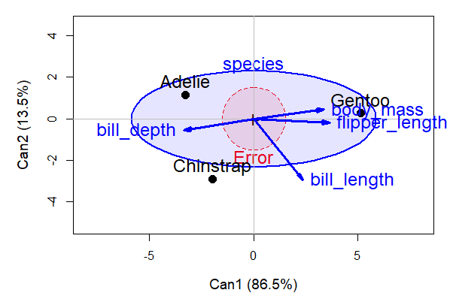
HE plots: Visual overview
Data ellipses
HE plot
Canonical space
Discrim axes
Notes:
The HE plot framework starts with data ellipses for the groups in a multivariate linear model
An “HE plot” summarizes the evidence for differences among groups in a MANOVA design
Equally, this can be cast as a discriminant analysis problem
A simple description can be seen in an HE plot in canonical space

Slide 31


Hypothesis tests in linear models
Hypothesis tests
ANOVA: Do group means differ? (Assume equal within-group variances)
How big is hypothesis variation relative to error variation?
MANOVA: Do group centroids differ?
How many dimensions?
(Assume equal within-group covariances)
How big is H relative to E?
Eigenvalues λ_{i}, i=1:min(p,df_{H}) of H E⁻¹
Wilks’ Λ = ∏_{i} (1-λ_{i})
Hotelling-Lawley trace Σ_{i} λ_{i}
Roy max root: λ₁

Slide 32
Response dimensions
Means on Y₁ and Y₂ are nearly perfectly correlated
Means on Y₁ and Y₂ have a low correlation
Y₂
Y₂
Y₁
Y₁
Only 1 dimension required to understand the group effect
Two different aspects are reflected in group means

Slide 33





Visualizing SSP_{T} = SSP_{H} + SSP_{E}
=
+
scale & overlay
pool→ SSP_{E}
Within
Total
Between

Slide 34


HE plots: Visualizing MLM tests
MLM: lm(cbind(bill_length, bill_depth, flipper_length, body_mass) ~ species)
How big is H (between) variation relative to E (within) variation?
H: data ellipse of the fitted values (means)
E: data ellipse of the residuals (pooled w/in group)
Significance scaling: Effect of species signif. iff H ellipse anywhere outside E ellipse!
Data ellipses
HE plot
Notes:
How can we understand a MANOVA to test for differences among penguin species using various physical measurements?
Data ellipses show the bivariate scatter
The HE plot focuses on what matters in the MANOVA tests

Slide 35

HE plots: Visualizing MLM tests
MLM: lm(cbind(bill_length, bill_depth, flipper_length, body_mass) ~ species)
How big is H (between) variation relative to E (within) variation?
H: data ellipse of the fitted values (means)
E: data ellipse of the residuals (pooled w/in group)
Significance scaling: Effect of species signif. iff H ellipse anywhere outside E ellipse!
Contrasts or 1 df linear hypotheses plot as conjugate 1D ellipses
Notes:
There is beautiful geometry here. Linear hypotheses correspond to conjugate ellipses of dimension = df

Slide 36

HE pairs() plots
The pairs() method for mlm objects gives all pairwise HE plots in a scatterplot matrix format in data space.
pairs(peng.mod0, size="effect",
fill=c(TRUE, FALSE))
Something new here:
avg. bill depth is negatively correlated with “size” variables – larger penguin species have smaller bill depths (curvature?)
correlation of avg. bill depth with body mass nearly -1

Slide 37




Multivariate Juicers
Squeeze the most flavor from your data in low-D space
data
insight
Biplot: The data juicer
CDA plots: The MANOVA juicer
Notes:
With more than a few variables, you can gain greater understanding with a multivariate juicer.
I know this is SO cheesy! But I find this a nice analogy to explain what we do with low-D methods

Slide 38


Low-D displays of High-D data
High-D data often shown in 2D views – orthogonal projections in variable space: scatterplots!
Dimension-reduction methods (e.g., PCA) project the data into subspace with optimal properties – account for largest variance
Cover image of Hofstadter, Gödel, Bach & Escher
Notes:
We are used to looking at High-D data in projected 2D views -- scatterplots

Slide 39
PCA, CDA & Biplots
For multivariate data, often want to view the data in a low-D space that extracts the most “juice”
PCA: finds weighted sums of variables which are:
Uncorrelated
Account for maximum variance
CDA: finds weighted sums to account for greatest MANOVA between-group variance (H wrt E)
Biplot: a 2D (or 3D) plot of the largest PCA / CDA dimensions--
Vectors in this plot show the original data variables
Points in this plot show the observations
Data ellipses here show within group relations

Slide 40


Biplot: The data juicer
peng.pca <- prcomp (~ bill_length + bill_depth + flipper_length + body_mass)
library(ggbiplot)
ggbiplot(peng.pca, obs.scale = 1, var.scale = 1,
groups = peng$species, ellipse = TRUE, circle = TRUE)
PC1, PC2 ~ 88.1% of variance
PC1: largely flipper length & body mass: “penguin size”
PC2: relates to “bill shape”
Easy to characterize the species in terms of these variables
See: https://rpubs.com/friendly/penguin-biplots

Slide 41


Canonical discriminant plots: The MANOVA juicer
As with the biplot, we can visualize MLM for all responses by projecting H and E into low-rank space
Canonical projection: $Y→Z=YE^{−1/2}V$ where V = eigenvectors of HE⁻¹
This is the view that maximally discriminates among groups
CD HE plot: vectors show structure coefs (correlations) of variables w/ CD dimensions
Biplot of canonical scores
HE plot of canonical scores

Slide 42
MLM diagnostics
Homogeneity of (co)variance
Residuals: multivariate normality, outliers
Multivariate influence

Slide 43




Visualizing equality of (co)variance
In the univariate LM, we assume Var(e)= constant, σ². For one-way ANOVA:
The analog for the MLM is equality of within-group covariance matrices
Tests:
Univariate- Levine’s test
Multivariate: Box’s M test
How to visualize???
DATA ELLIPSES

Slide 44

heplots::covEllipses()
Display data ellipses for each of the groups + the pooled within-grp covariance
How similar are they in size & shape?
covEllipses(peng[, 3:6],
group = peng$species,
variables = 1:4,
fill = TRUE, fill.alpha = 0.1)

Slide 45

Centering
Easier to see diff^{ces} if we center the data ellipses at the grand means
covEllipses(peng[, 3:6],
group = peng$species,
center = TRUE,
variables = 1:4,
fill = TRUE, fill.alpha = 0.1)
Gentoo often inside- smaller
Adelie often outside- larger

Slide 46

Box’s M test
> (bm <- boxM(peng.mod0))
Box's M-test for Homogeneity of Covariance Matrices
data: Y
Chi-Sq (approx.) = 74.731, df = 20, p-value = 3.02e-08
> plot(bm)
The plot method for boxM shows the contributions to Box’s M test
log |S₁|, … log |S_{g}| and log |S_{p}|
Gentoo is “smaller” than the others
But: Box’s M test is overly sensitive to small departures from equality

Slide 47

Multivariate normality & outliers
The MLM assumes the residuals E from a model Y = X B + E are multivariate normal
E_{n×p} ~ MVN(μ, Σ_{p×p} )
→ Mahalanobis squared distances are ∼ χ²_{p}
$D^{2}$= $(x−\overline{x})′$S⁻¹ $(x−\overline{x})′$ ∼ χ²_{p}
→ QQ plot of D² vs. chi-square quantiles should be linear
Multivariate outliers appear as points whose D² >> χ²_{p}
Implemented in heplots::cqplot()

Slide 48


heplots::cqplot()
peng.mlm <- lm(cbind(bill_length, bill_depth, flipper_length, body_mass)
~ sex + species, data=peng)
cqplot(peng.mlm, id.n = 3 )
cqplot(peng.mlm, id.n = 3 , detrend = TRUE)

Slide 49


Weird birds
To understand why these are outliers, we can label the points in scatterplots
283: Chinstrap, Male, Torgerson– Extra long bill, short flippers– “Pinochio”
179: Gentoo, Male, Biscoe– Extra long & deep bill, long flippers– “Cyrano”
10: Adelie, Female, Dream: Extra deep bill– “Hook-nose Sally”

Slide 50

Unusual data: Influence & leverage
“Unusual” observations can have dramatic effects on least-squares estimates in linear models
The leverage-influence quartet illustrates the impact of adding one additional point
What “harms” the fitted model?
1: OK
2: Outlier on y- no harm
3: Outlier on x- no harm
4: Outlier on both- BAD
Heuristic formula:
Influence = X leverage × Y residual

Slide 51

Unusual data: precision
Unusual points also affect precision of estimates, as shown by data ellipses
O: no bias, but increases std. error
L: decreases std. error (“good leverage” point)
OL: biases slope & increases std. error

Slide 52

Classic univariate influence plot
For univariate models, the classic plot shows studentized residuals vs. hat values, bubble size ~ Cooks D (influence)
This plot is difficult to read, because the regions of high influence are the outside corners
Duncan’s data on occupational prestige
BAD
BAD

Slide 53

Showing CookD contours
A more informative version shades the background with contours of constant Cook’s distance

Slide 54

Multivariate influence
How can we extend this to a MLM with multiple responses?
mymlm <- lm( cbind(y1, y2, y3) ~ x1 + x2 + x3, data=mydata)
and then get useful diagnostics and plots with
influence(mymlm)
hatvalues(mymlm)
influencePlot(mymlm, ...)
As well, cases can be jointly influential, so we might want to compute measures of change in coefficients or fitted values when m > 1 cases are deleted
mvinfluence implements the methods described by Barrett & Ling (1992)

Slide 55
Multivariate influence
Multivariate analogs of Hat values, studentized residuals, Cook’s D, DFFITS, … for deletion of m=1,2,…
For the MLM, Y = X B + E, define
X_{I} = submatrix of X whose m rows are indexed by I
X_{(I)} = complement of X, deleting those m rows
Y_{I} , Y_{(I)} defined similarly
B_{(I)} = (X’_{(I)} X_{(I)})⁻¹ X_{(I)} Y_{I} coefficients with cases in I deleted
deletion residuals: E_{(I)} = Y_{(I)} – X_{(I)} B_{(I)}
Hat values: H_{I} = X_{I} (X’ X)⁻¹ X_{I}
Q_{I} analog of H_{I} for residuals: Q_{I} = E_{I} (E’ E)⁻¹ E_{I}
Generalized Cook distance

Slide 56

Multivariate influence

Slide 57



Slide 58


Slide 59

Influence diagnostics: influencePlot()
data(Rohwer, package="heplots")
Rohwer2 <- subset(Rohwer, subset=group==2)
Rohwer.mod <- lm(cbind(SAT, PPVT, Raven) ~ n+s+ns+na+ss, data=Rohwer2)
influencePlot(Rohwer.mod, id.n=4, type="stres")

Slide 60

Influence diagnostics: LR plot
The LR plot shows log(L) vs log(R)
Main idea: Influence = Leverage (L) × Residual (R) → log(Infl) = log(L) + log(R
Contours of constant influence (Cook’s D) are lines with slope = -1
This makes it very easy to read, simplifies interpretation
influencePlot(Rohwer.mod, id.n=4, type=“LR")

Slide 61


Who are the influential penguins
influencePlot(peng.mlm, id.n=3, type="stres")
influencePlot(peng.mlm, id.n=3, type=“LR")

Slide 62
Summary

